Slide 1

Mini Project-I (K24MCA18P) Odd Semester Session 2024-25
<Cricket score>
<Team Leader Name- Vaibhav sharma and University Roll Number- 2426mca2427>
<Member Name- Shiv kumar and University Roll Number- 2426mca704 >
<Member Name- Shubham singh and University Roll Number- 2426mca707 >
Project Supervisor:
Supervisor Name
Designation

Slide 2
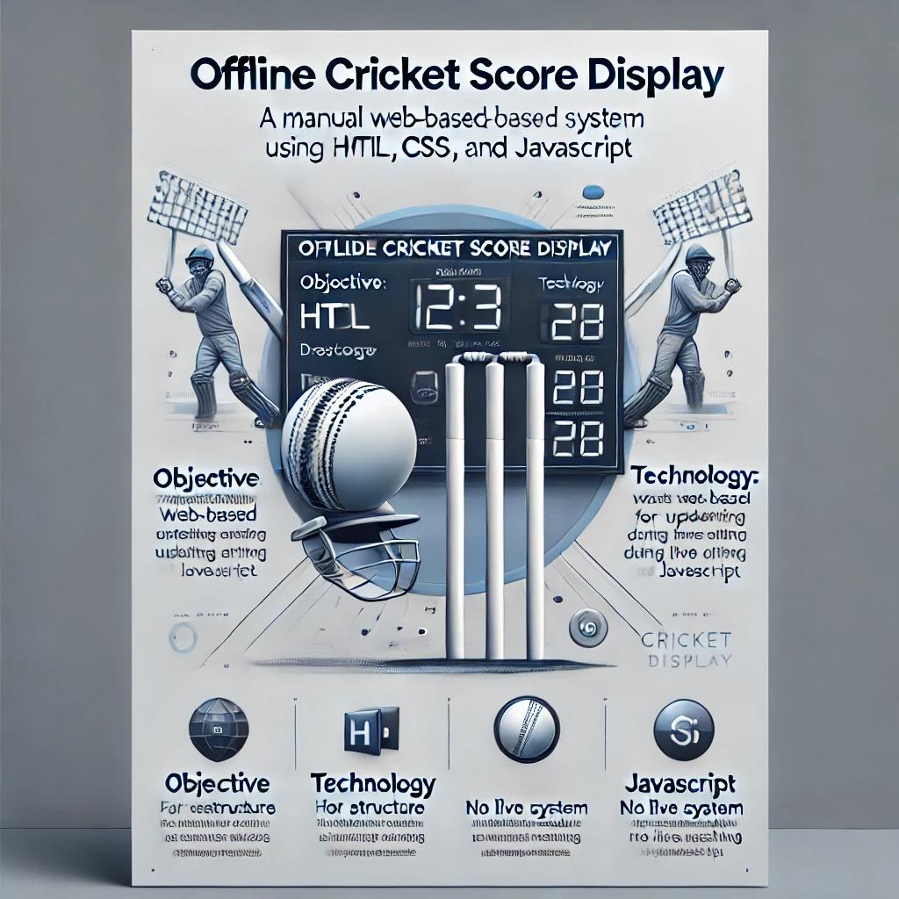

Slide 3
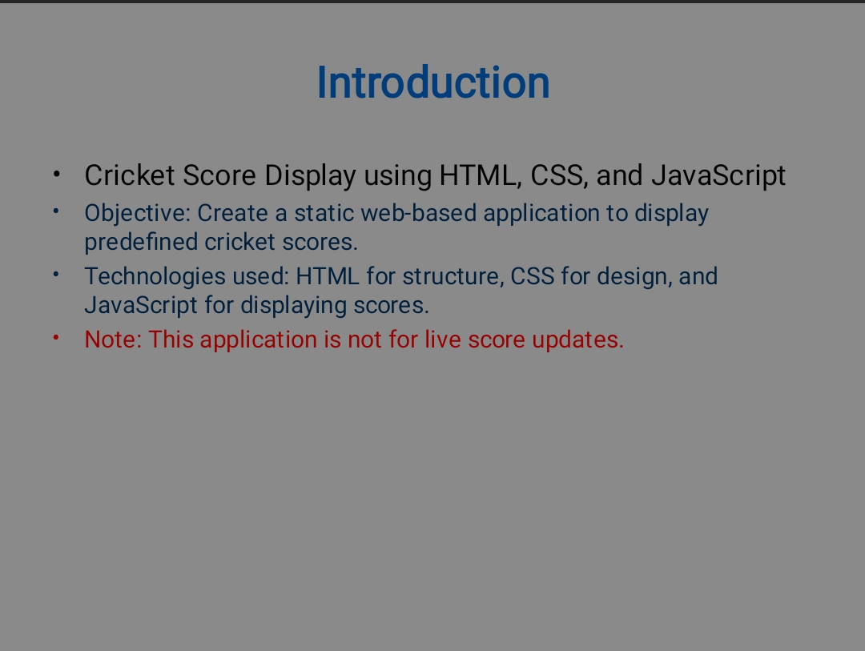
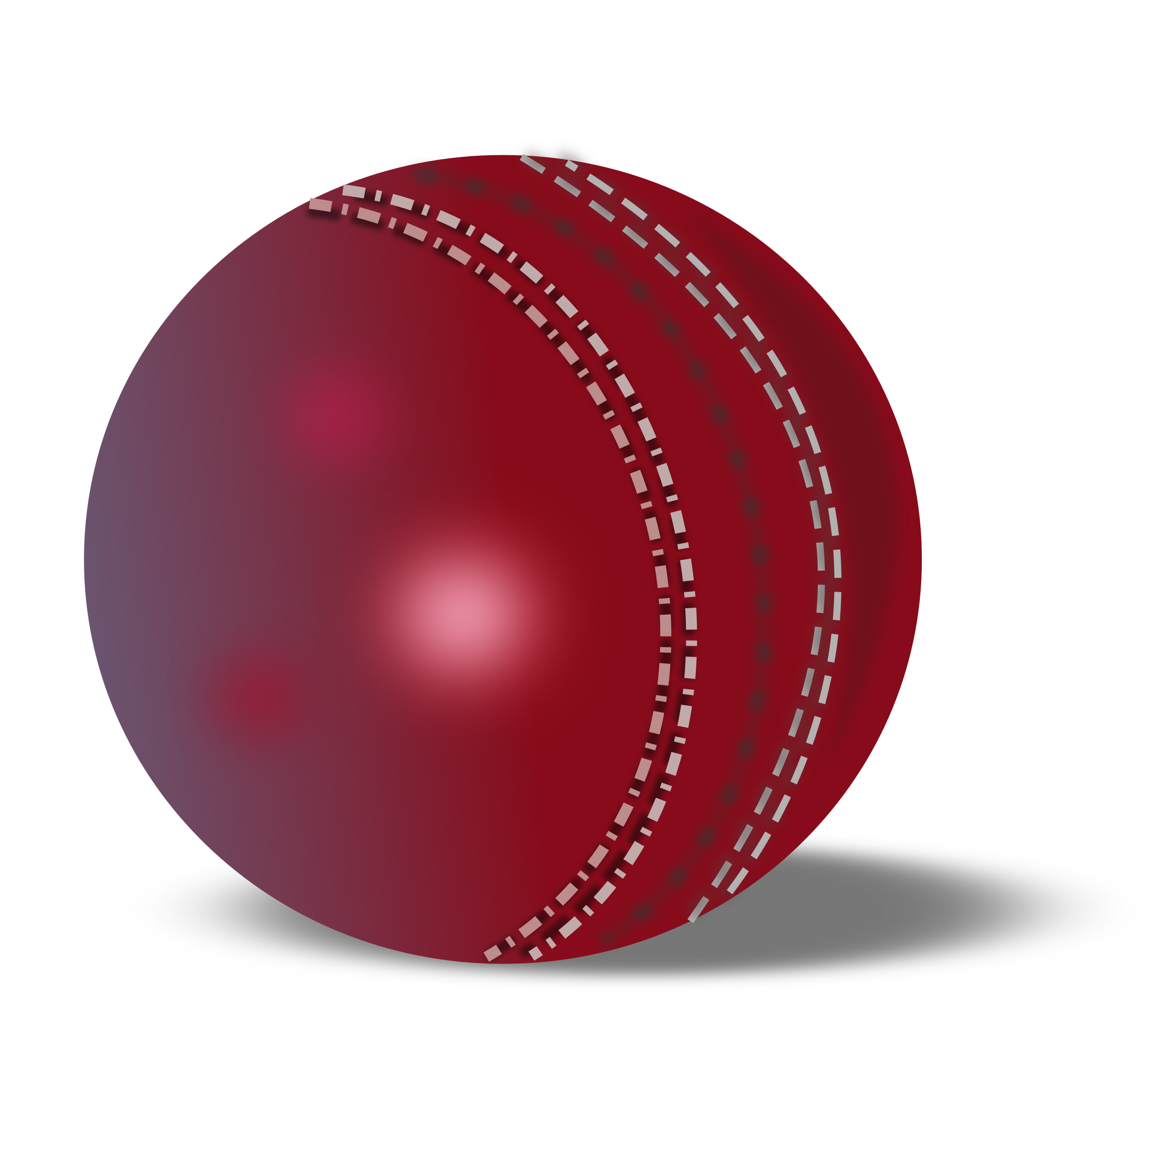
This Photo by Unknown Author is licensed under CC BY-NC

Slide 4
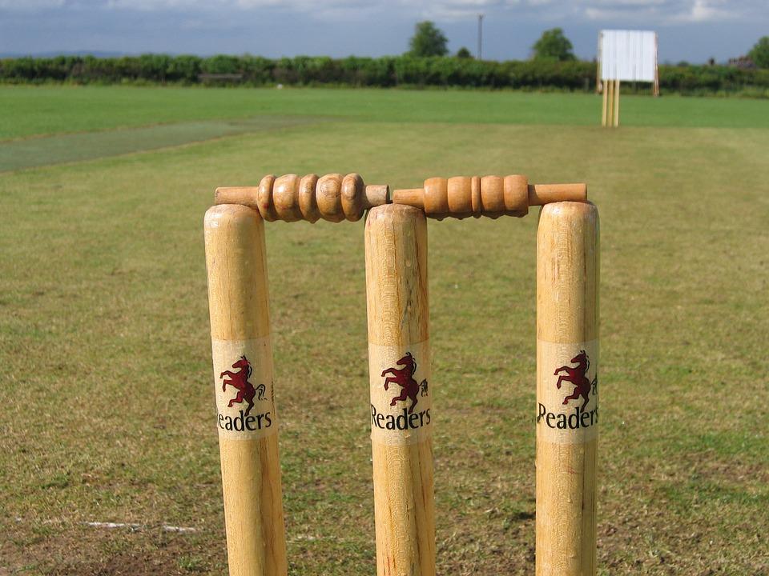
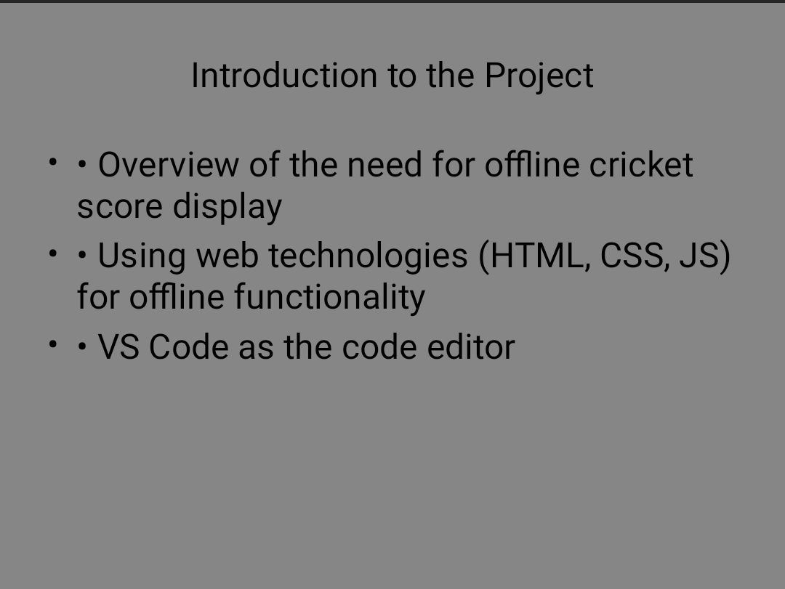

Slide 5
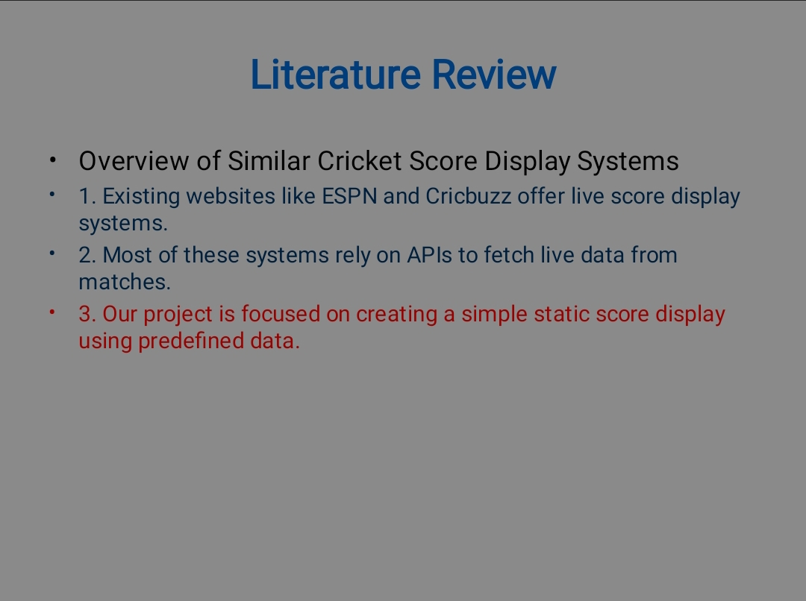

Slide 6
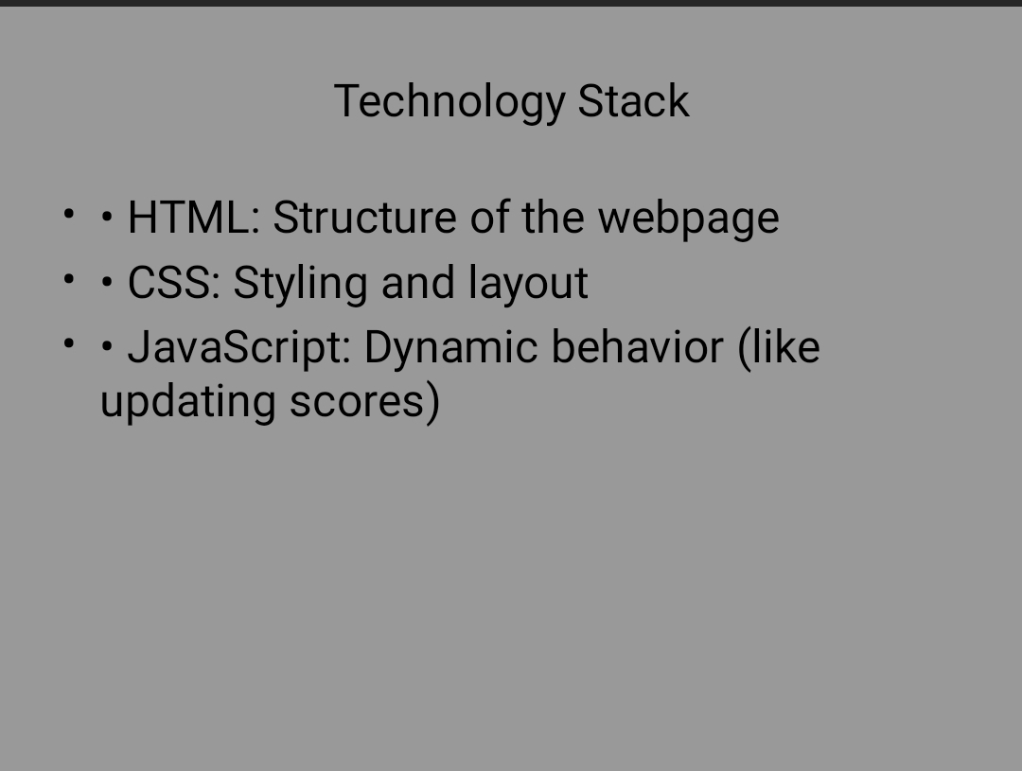

This Photo by Unknown Author is licensed under CC BY-SA-NC

Slide 7


Slide 8
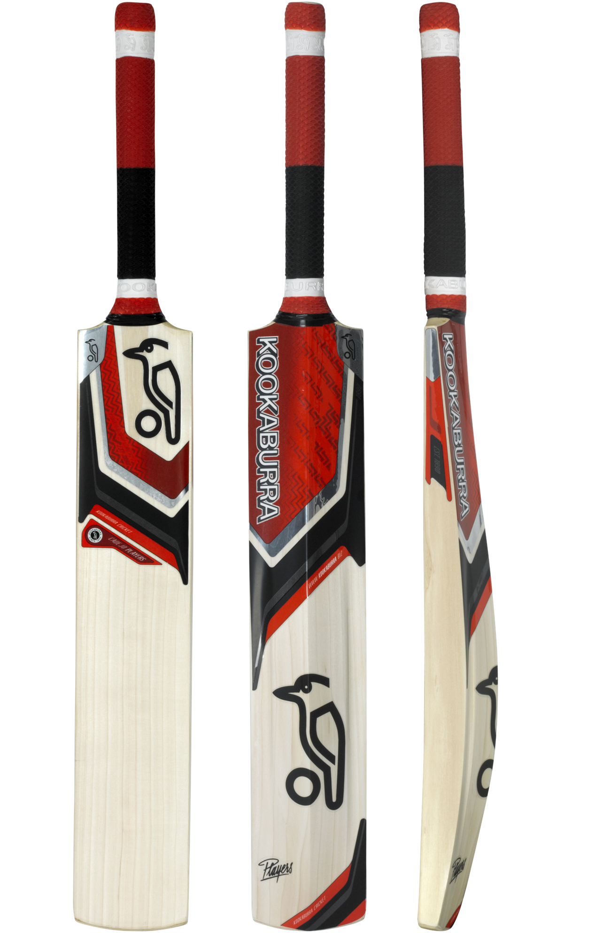
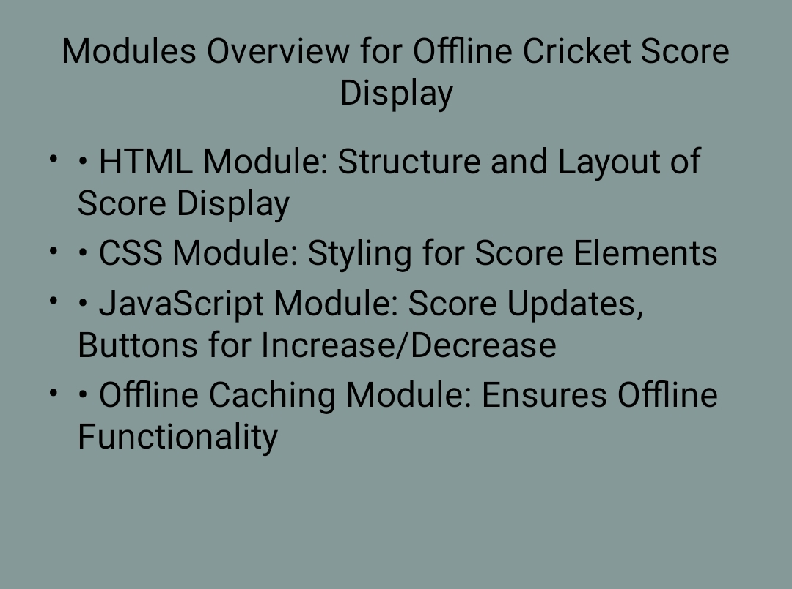
This Photo by Unknown Author is licensed under CC BY-NC

Slide 9
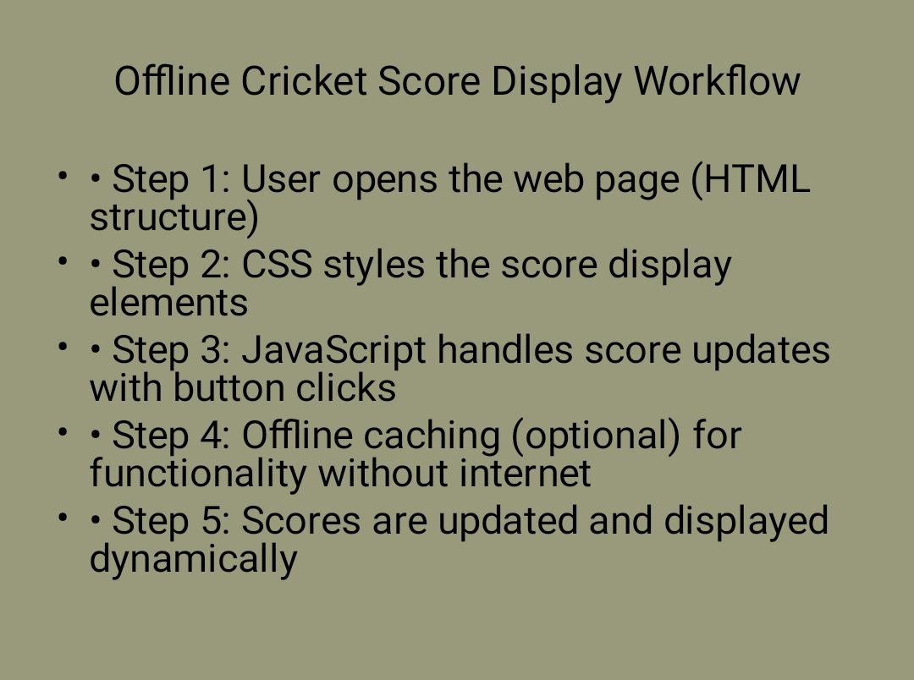

Slide 10


